Slide 1



Divvy Bike Share Analysis
Samantha Rockey

Slide 2

Instructions
The goal of this project was to demonstrate different analysis skills to clean and analyze using various tools. I choose to use Excel and Rstudio for my project. The original directions can be found here. The data sets can be downloaded from here.

Slide 3
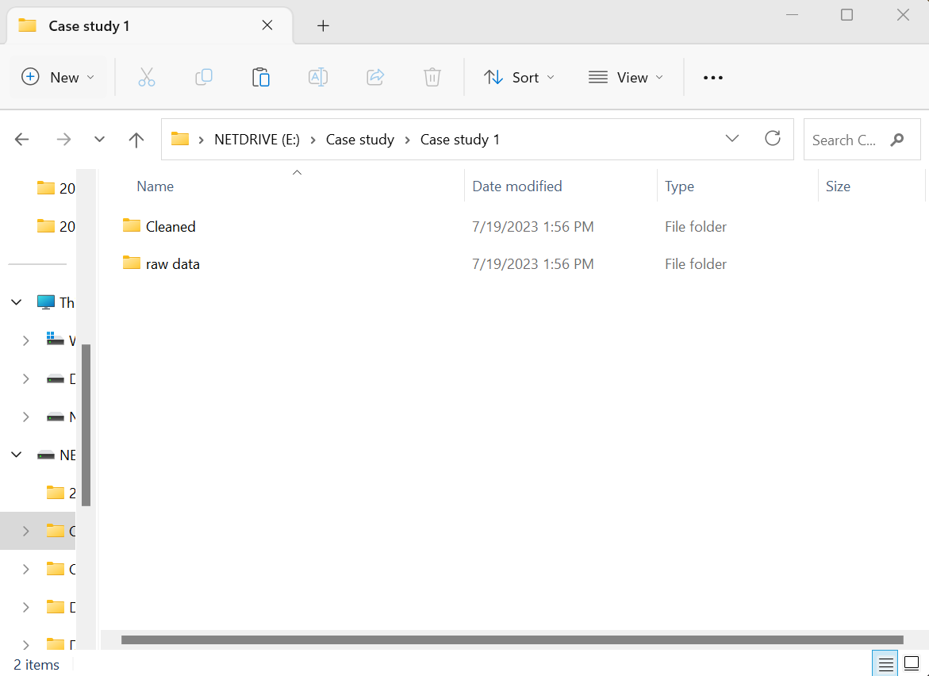
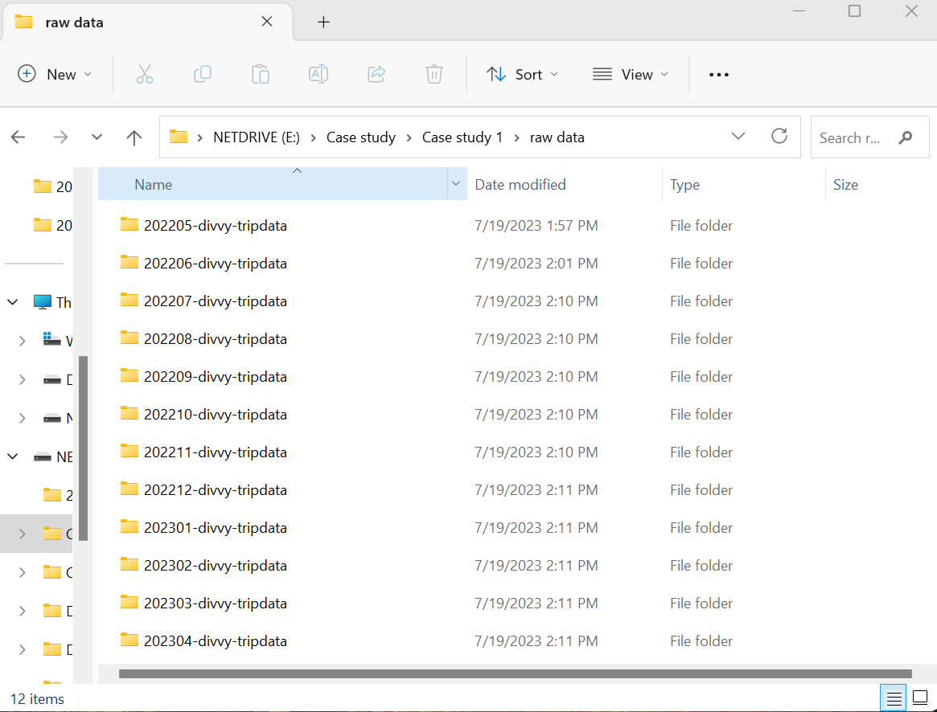
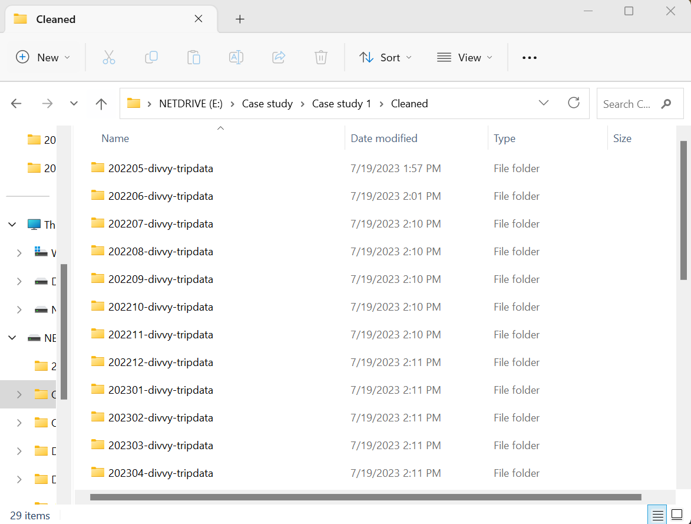
Download and Organize the Datasets
I downloaded the datasets from May 2022 through April 2023. I kept original copies of the raw data in one folder and made copies in another to clean and analyze. This helps make sure that if there are any issues with data integrity later, I still have copies of the raw information.

Slide 4
Stake Holder Goals
The stakeholders would like an in-depth analysis of the past year of bike-share data that will assist them with making a marketing strategy for encouraging casual riders to opt into the membership program that they offer. With this goal in mind, I hope to answer the following questions:
When are the bikes used the most? Morning or evening? Mondays or Thursdays? Does the time of year make a difference?
Are there currently more membership users or casual users?
What type of bikes are used the most?
The answers to these questions will help our stakeholders develop an appropriate marketing strategy to expand their business.

Slide 5
Cleaning the Data
I started the cleaning process by reviewing the column names.
Started_at
Start_station_name
Ride_id
Rideable_type
Start_station_id
End_station_name
End_station_id
Start_lat
Start_lng
End_lat
End_lng
Member_casual
After reviewing the column names and the analysis questions, I determined that some of the columns were unnecessary for my analysis, so I removed them. The columns that I removed included:
Start_station_name
Start_station_id
End_station_name
End_station_id
Start_lat
Start_lng
End_lat
End_lng

Slide 6

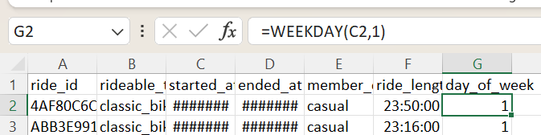
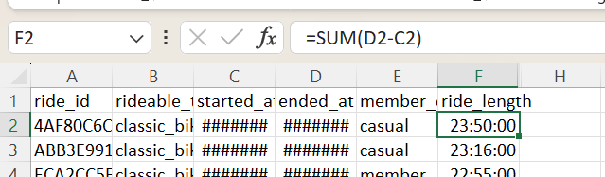
Cleaning the Data
Next, I applied filters to each column and removed any rows with empty cells. Normally, I would discuss with stakeholders how they would like the empty cells to be handled but since this is just a project, I chose to remove those specific rows. After that, I added the columns ride_length and day_of_week.

Slide 7
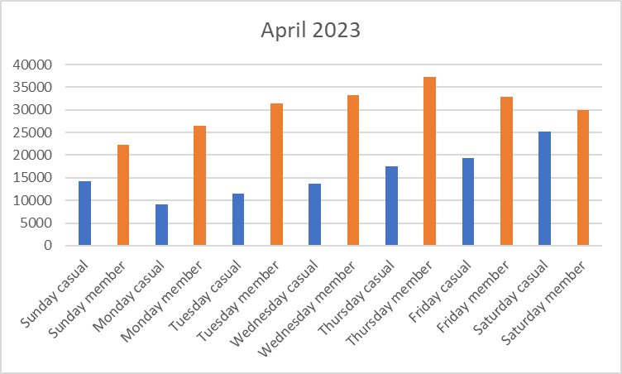
Analysis
Let’s answer the first question: When are the bikes used the most? Morning or evening? Mondays or Thursdays? Does the time of year make a difference?
To answer this question, I made some pivot tables and charts to go along with them, that compare different numbers of rides per hour, rides per day of the week, and rides per day of the month. To break those numbers down further, I also added members and casual riders.

Slide 8
Let’s start with the number of members and casual riders. There are 10% more members than casual riders. The number of casual riders is where we need to be targeting our marketing strategy to convert casual riders to membership riders.
Members vs casuals

Slide 9
Total Rides per weekday
This looks at the average daily rides per day over the course of the past year. Sundays have the most rides per day.
This is a look at the total number of rider for casual riders. Their most popular ride day is Sundays and Saturdays.
Members have a more even number of rides per day. Their most popular day is surprisingly Tuesdays and Wednesdays. We will investigate this further.

Slide 10
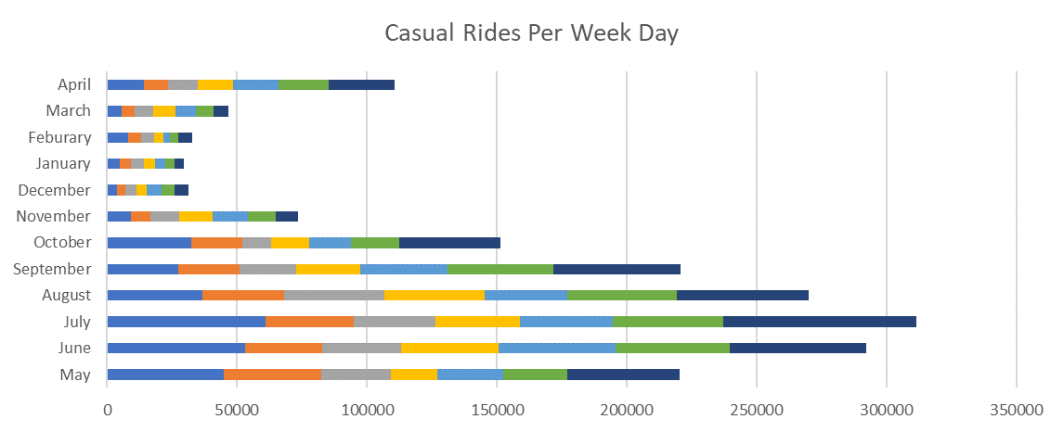
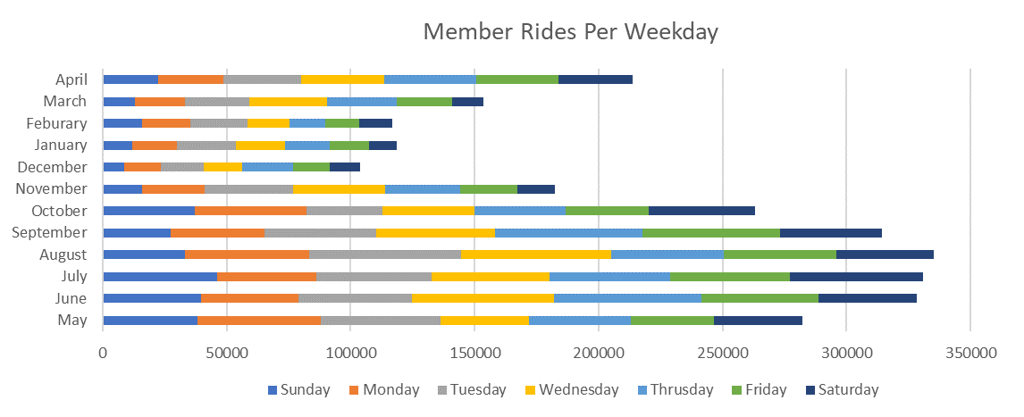
Rides per month
There are more total rides per month during the late spring through early fall months. The casual riders typically ride more frequently in the summer months. Members are more likely to ride earlier in the spring and slow down in late fall. This trend is most likely due to the average daily temperatures in Chicago.

Slide 11
Start times
The average start time has a strong peak at 5 pm with a second one at 12 pm and lastly 8 am. This is likely due to the typical 9 to 5 work schedule. This is something to keep in mind while making our marketing strategy.

Slide 12

Ride Length
Members average ride length is significantly longer than casual riders. Further investigation should be conducted to see the reason why members typically ride longer than casual riders.

Slide 13
Types of bikes
The classic bike had the most rides with the electric bike coming in second. The docked bike was only ridden by casual riders, and the reasoning should be further investigated. This could be due to the membership not including the docked bike or that there may be an issue with the technology involved in renting the bike.

Slide 14
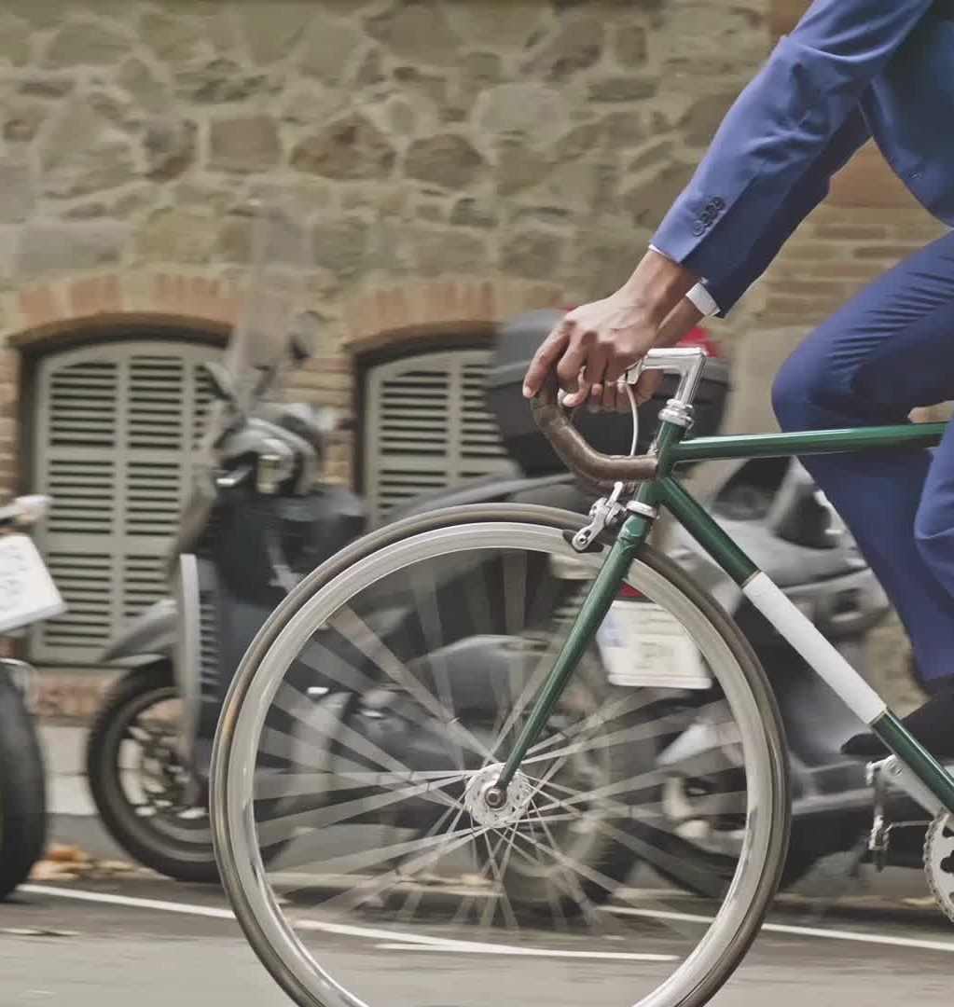

Final thoughts
Based on my analysis, I believe that the following items should be taken into consideration when creating a targeted marketing campaign for casual riders:
Start the campaign in the late winter to early spring when rides start to pick up in frequency
Most riders rent bikes at 8 am, 12 pm, and 5 pm
Casual riders have shorter ride lengths then members
Only casual riders rent docked bikes

